Slide 1

Score Zone (A Football Tournament Manager)
By
Soham Ghatpande
Parth Patil
Shantanu Patil

Slide 2
CONTENTS
Introduction
Working
Features
Applications
Technologies Used
Future Scopes
Conclusion

Slide 3
INTRODUCTION
Currently, many football teams in many cities of India play tournaments organized by various organizers.
These organizers do not have a proper and efficient way of managing these tournaments.
Instead of having the benefits of a digital world where they can manage all of their data digitally, these organizers have to do a lot of paperwork to keep the information related to these tournaments.
The main objective of this project is to build a website for these organizers, who belong to various cities, to organize tournaments in their areas by managing tournaments through our web application
Through this system, they can manage and maintain all the data related to these tournaments.

Slide 4
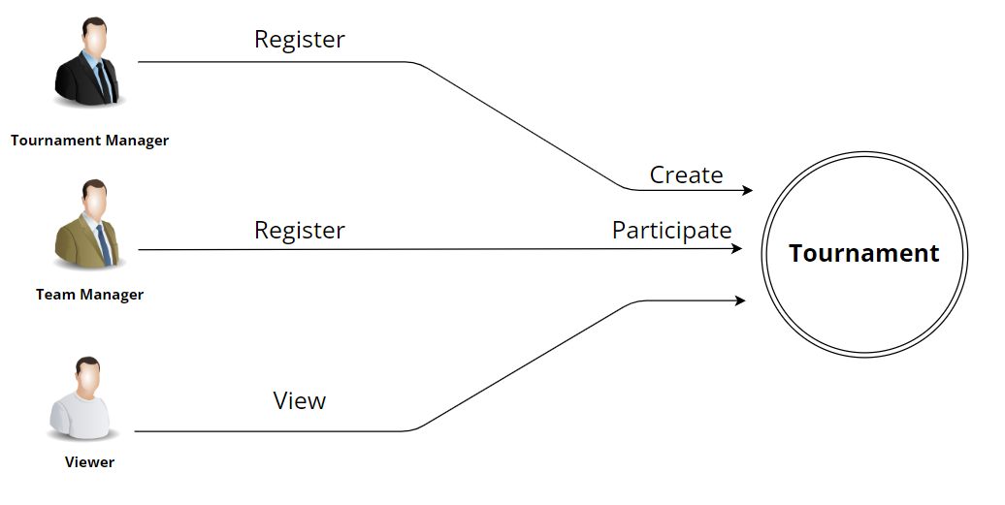
WORKING

Slide 5
FEATURES
Create Tournaments (Tournament Manager)
Create Matches (Tournament Manager)
Register Teams (Team Manager)
Participate In Tournaments (Team Manager)
Score Update (Match Updater)
View Tournaments (Viewer)
View Teams (Viewer)
View Matches (Viewer)
View Score (Viewer)

Slide 6
APPLICATIONS
Tournament Hosting.
Players Data Access.
Teams Data Access.
To make analysis of local Talent.

Slide 7
TECHNOLOGIES USED
React JS, Bootstrap-(Front-End).
Java, Spring Boot REST API, JPA-(Middle-Tier).
MySQL-(Back-End).

Slide 8
FUTURE SCOPES
• New Modes of Tournament – Currently we have only a knock-out mode in our System but in the future, we are planning to add Round-Robin, Groups-Stage, etc. modes in our System.
• Choosing Players from the Existing record – We will add a Feature to add existing players while creating a new team for a tournament.
• UI –Enhancement – In the Enhanced Version, our System will have Advance UI.
• Viewer’s Features – In the Updated Version More Features will be given to the.
Viewer like – Match Prediction, Comments, Can see Live Commentary, Choosing a Favourite Player.
•Sponsors will be able to Sponsor a Tournament/Teams.

Slide 9
CONCLUSION
• Our System will provide a platform for local organizers to organize a Tournament.
• The local Teams, Players will get recognition.
• With this system Resources Can be Managed in a Better way.
• Viewers will get a chance to Track their Favourite Teams and Players.
So our System has taken down all non-core efforts for managing the tournament
and Taken the whole process online, also we have multiple logins so processes
of individuals has been isolated.

Slide 10
THANK YOU.

